Slide 1
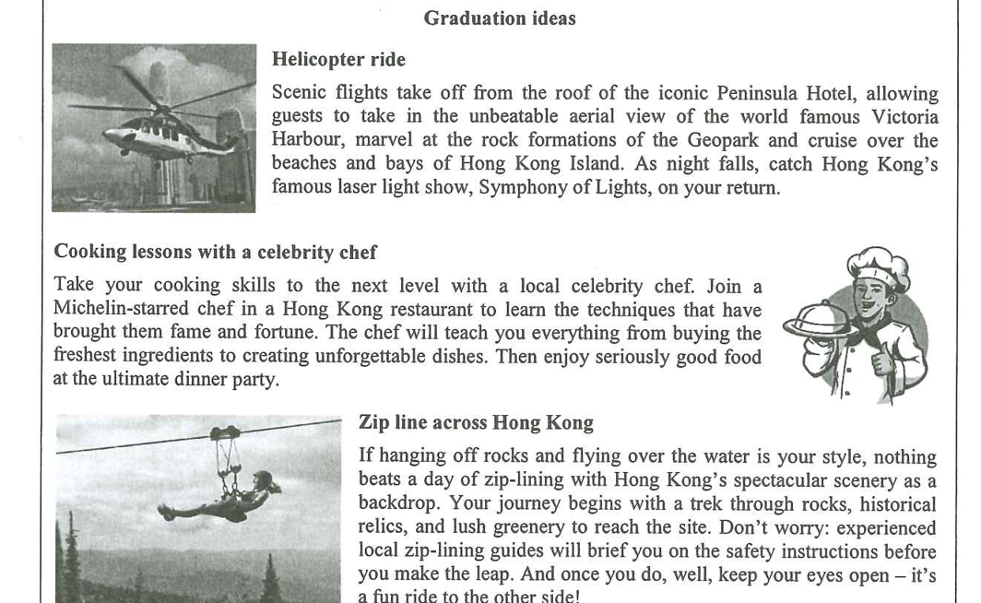
GRADUATION IDEAS
DSE PAPER 4 · SPEAKING PRACTICE
Graduation
Celebration
Planning and paying for the end
of six years together
DSE 2023 Paper 4 Set 2.3 · Lesson 4
What would you choose?

Slide 2

01 WARM-UP
Two questions to get you talking
QUESTION 1 (Student A)
QUESTION 2 (Student B)
Would you like to go on a helicopter ride?
Would you like your teachers to attend your graduation celebration?
2

Slide 3
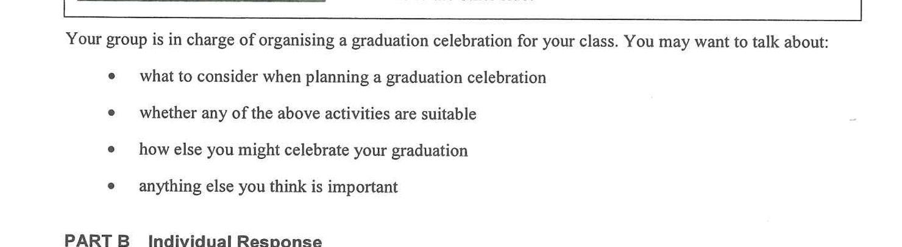
02 PART A – GROUP INTERACTION
Your discussion task
3

Slide 4

03 PART A – DISCUSS
Q1 What to consider when planning
SUGGESTED IDEAS — noun phrases
a budget the whole class can afford
activities everyone can join
a date that fits the post-exam calendar
4

Slide 5

03 PART A – DISCUSS
Q2 Are the three activities suitable?
SUGGESTED IDEAS — noun phrases
YES: a real once-in-a-lifetime treat
YES: shared memories and photos for the yearbook
NO: too pricey for a whole class
NO: safety and fitness limits
5

Slide 6

03 PART A – DISCUSS
Q3 How else could you celebrate?
SUGGESTED IDEAS — noun phrases
a farewell dinner with a slideshow
a school-hall party with music and games
a low-cost outing or camp
6

Slide 7

05 SPEAK FOR 1 MINUTE
Part B – Question 7
Would you like to be on the school graduation organising committee?
SUGGESTED IDEAS — noun phrases
YES: a chance to shape the event
YES: useful leadership and budgeting experience
NO: the work collides with my DSE revision
NO: the blame when something goes wrong
7

Slide 8

05 SPEAK FOR 1 MINUTE
Part B – Question 8
Is a graduation celebration meaningful to you?
SUGGESTED IDEAS — noun phrases
YES: a proper send-off for six years
NO: the friendships matter more than the party
8

Slide 9

06 VOCABULARY UPGRADES
Say it like this — from the lesson
The helicopter ride would be a once-in-a-lifetime experience for the class.
Someone has to take charge of the arrangements — and the budget.
The cost per head would put some classmates off.
It gives us a proper send-off and a milestone worth marking.
A slideshow of five years of photos is my idea of a farewell event.
Not every activity suits a whole class of thirty.
I would rather plan the programme than complain about it afterwards.
The committee role would strengthen my university application.
9

