Slide 1
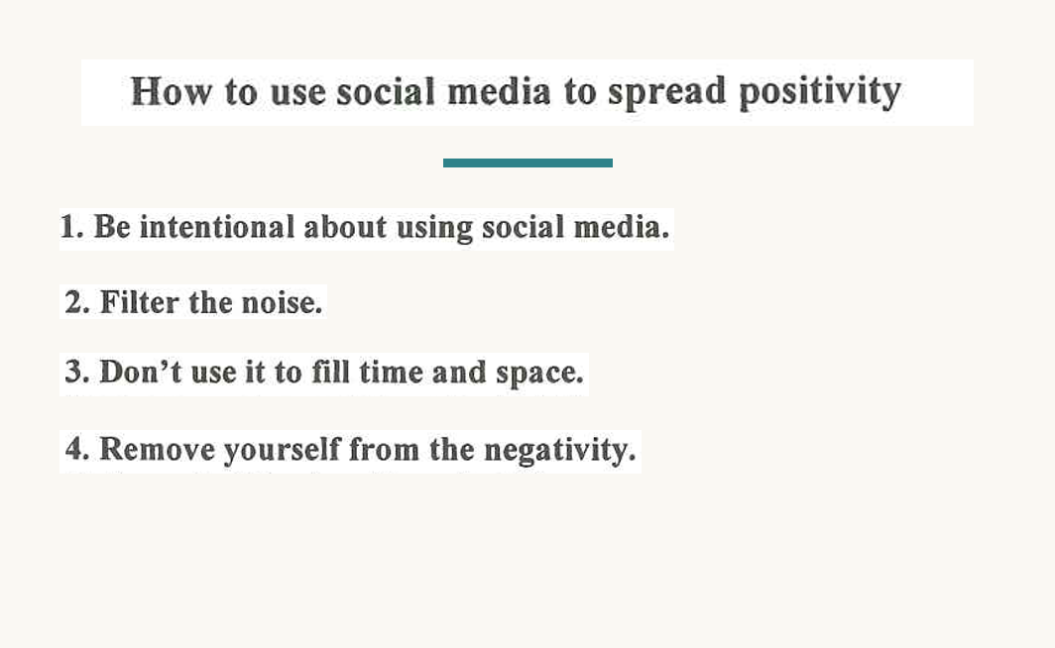
THE MENTAL HEALTH & WELLNESS CLUB
DSE PAPER 4 · SPEAKING PRACTICE
Social Media
and Well-being
Positivity, popularity and
the pressure of the feed
DSE 2023 Paper 4 Set 4.3 · Lesson 5
How much is too much?

Slide 2
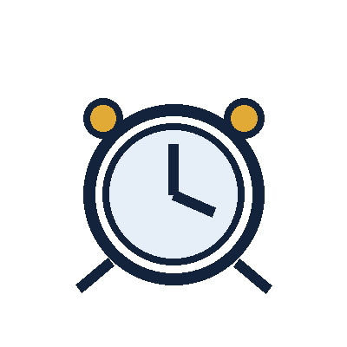
01 WARM-UP
Two questions to get you talking
QUESTION 1 (Student A)
QUESTION 2 (Student B)
Do you use social media?
Would you like to be popular on social media?
2

Slide 3
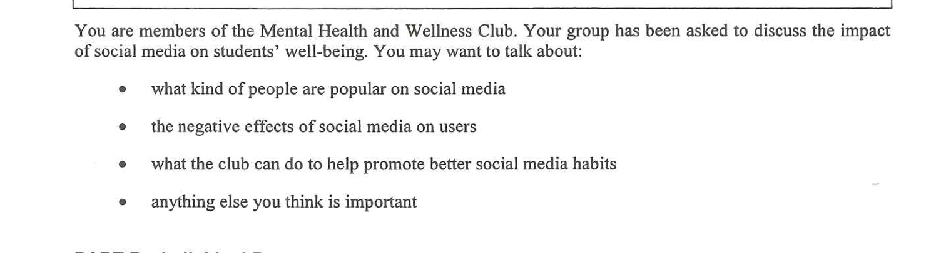
02 PART A – GROUP INTERACTION
Your discussion task
3

Slide 4
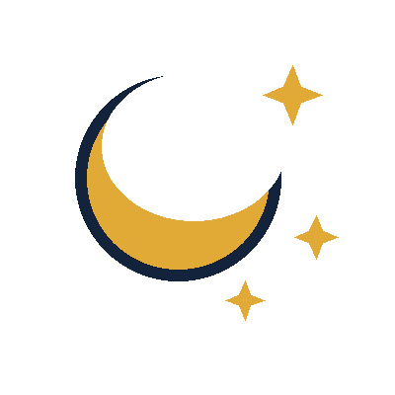
03 PART A – DISCUSS
Q1 Who becomes popular?
SUGGESTED IDEAS — noun phrases
accounts with an extreme opinion
the perfect-looking lifestyle
the fastest, shortest content
4

Slide 5
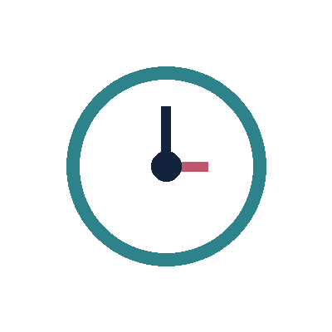
03 PART A – DISCUSS
Q2 The negative effects on users
SUGGESTED IDEAS — noun phrases
anxiety from constant comparison
lost concentration and lost sleep
a lack of compassion in the comments
a false picture of other people’s lives
5

Slide 6

03 PART A – DISCUSS
Q3 What the club can do
SUGGESTED IDEAS — noun phrases
a no-phone hour or a screen-time challenge
a peer-led workshop on spotting fake lives
a quiet space and someone to talk to
6

Slide 7

05 SPEAK FOR 1 MINUTE
Part B – Question 7
Do you agree there is a lack of compassion on social media?
SUGGESTED IDEAS — noun phrases
AGREE: the comment sections make it plain
AGREE: anonymity removes the consequences
DISAGREE: every crisis brings an outpouring of support
DISAGREE: compassion just looks different online
7

Slide 8

05 SPEAK FOR 1 MINUTE
Part B – Question 8
Does social media impact people’s self-esteem?
SUGGESTED IDEAS — noun phrases
YES: comparison is built into the app
NO: the impact depends on how you use it
8

Slide 9

06 VOCABULARY UPGRADES
Say it like this — from the lesson
My screen time is out of control — I check my feed out of habit.
I am chasing the approval of people I barely know.
There is a real lack of compassion in the comment sections.
Constant comparison damages users’ self-esteem.
Anonymity removes the consequences of what people write.
Curating your feed turns a harmful app into a useful one.
One more scroll at midnight costs an hour of sleep.
The club could raise awareness of screen time with a no-phone week.
9

