Slide 1
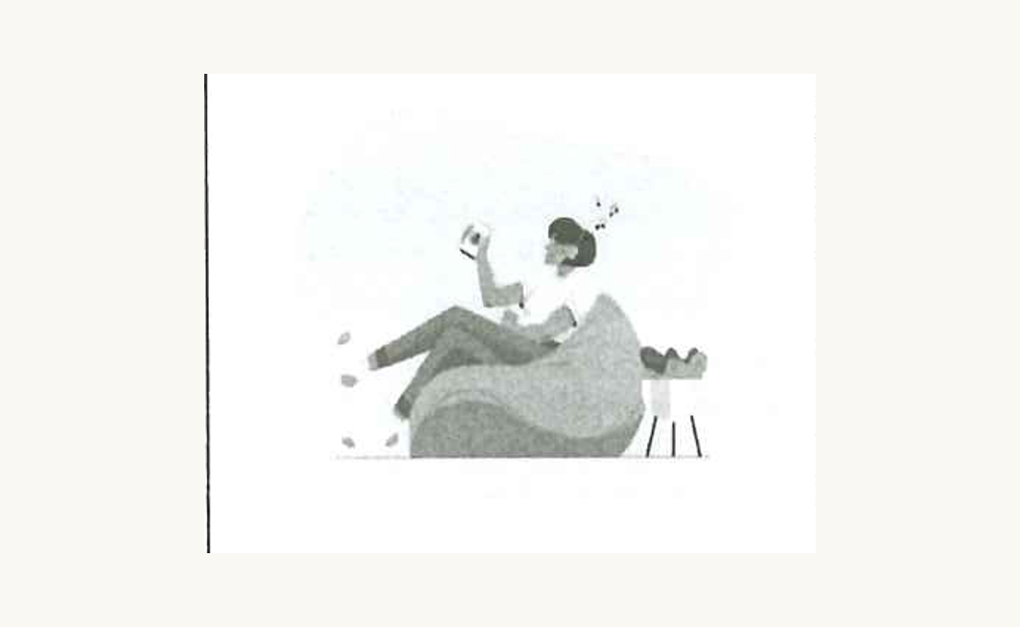
FAST-PACED VS SLOW-PACED
DSE PAPER 4 · SPEAKING PRACTICE
Time in Different
Cultures
Punctuality, pace and
the price of being late
DSE 2023 Paper 4 Set 7.1 · Lesson 6
Which one are you?

Slide 2

01 WARM-UP
Two questions to get you talking
QUESTION 1 (Student A)
QUESTION 2 (Student B)
Are you often late for school?
Is being on time important to you?
2

Slide 3
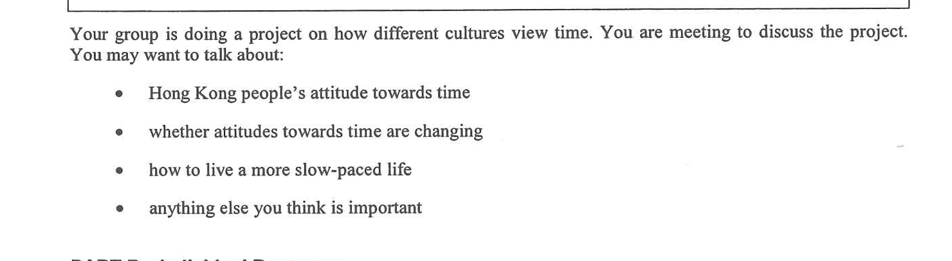
02 PART A – GROUP INTERACTION
Your discussion task
3

Slide 4

03 PART A – DISCUSS
Q1 Hong Kong’s attitude towards time
SUGGESTED IDEAS — noun phrases
the clock rules the day
being late reads as disrespect
schedules crowd out family and rest
4

Slide 5

03 PART A – DISCUSS
Q2 Are attitudes changing?
SUGGESTED IDEAS — noun phrases
YES: flexible hours and remote work
YES: more people choose slow travel and digital detoxes
NO: the 8 a.m. school bell has not moved
NO: delivery apps have made us less patient
5

Slide 6

03 PART A – DISCUSS
Q3 How to live more slowly
SUGGESTED IDEAS — noun phrases
leave blanks in the timetable
protect one long, offline meal with family
change what we measure
6

Slide 7

05 SPEAK FOR 1 MINUTE
Part B – Question 7
Is work-life balance important?
SUGGESTED IDEAS — noun phrases
YES: the health cost of burning out
YES: rest protects the quality of the work
NO: some seasons demand total commitment
NO: balance is a privilege some cannot choose
7

Slide 8

05 SPEAK FOR 1 MINUTE
Part B – Question 8
Do you agree that time is money?
SUGGESTED IDEAS — noun phrases
AGREE: billing by the hour makes it literal
DISAGREE: time spent with people cannot be priced
8

Slide 9

06 VOCABULARY UPGRADES
Say it like this — from the lesson
I am chronically late — punctuality is not my strong point.
Keeping a friend waiting tells them their time matters less than yours.
Hong Kong runs at a fast pace: everything is scheduled.
Seven lessons and tutoring leave no room for an unhurried evening.
Some offices now let staff start later and finish later.
We expect food in fifteen minutes, so the culture is speeding up.
A day off is an investment in the next week’s work.
Slower cultures are not lazier — they measure success differently.
9

